Slide 1
An Automata-based Approach for Scalable Verification of Quantum Circuits
Yu-Fang Chen¹, Kai-Min Chung¹, Ondrej Lengal²,
Jyun-Ao Lin¹, Wei-Lun Tsai¹, Di-De Yen¹ Academia Sinica, Taiwan¹
Brno University of Technology, Czech Republic²

Slide 2
Do not be scared!
We assume no background in quantum and minimal background in automata theory.

Slide 3
Outline
Minimal Quantum Background and Motivation
Quantum Circuit Verification
Evaluation

Slide 4
A 3-Bit Classical State
0
1
0

Slide 5
A 3-Qubit Quantum State
0
0
0
5%
0
0
1
2.5%
…
1
1
0
5%
1
1
1
1.5%

Slide 6
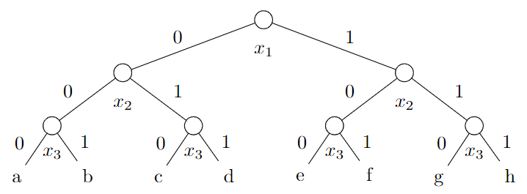
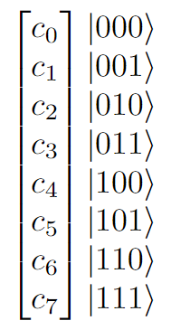
Tree as a Quantum State
A 3-bit quantum state

Slide 7
Quantum Gate and Tree Transformation
An example of apply X gate (negation) on qubit x₁.
Notes:
在 DD 的時代，一棵樹只能表達一個量子態。
How to encode a state into a tree? Notice that all leaves are complex numbers.

Slide 8
Quantum Circuit
A sequence of quantum gates viewed as tree transformations

Slide 9
Why Quantum Circuit Verification?
Increasing complexity of circuits
Infeasibility of testing due to the probabilistic features
Notes:
下面兩張圖只是為了讓大家感覺一下為何需要做驗證。probabilistic

Slide 10
Outline
Minimal Quantum Background and Motivation
Quantum Circuit Verification
Evaluation
Notes:
問題動機、相對應解法。
特殊數學模型因為驗證的需要，怎麼一次表達多個量子態。
因為操作很複雜，最後有時間才講。
在這之前，會先介紹驗證使用方式跟實驗結果，以及 TA 結構複雜的相對應解決方法。

Slide 11
Classical Hoare triple
For any predicates P and Q and any program S, {P} S {Q} says that if S is started in (a state satisfying) P, then it terminates in Q.
Precondition
Postcondition
Notes:
給你前提
經過程式之後
是否滿足結論？

Slide 12
Classical Hoare triple
For any predicates P and Q and any program S, {P} S {Q} says that if S is started in (a state satisfying) P, then it terminates in Q.
…
…
Notes:
給你前提
經過程式之後
是否滿足結論？

Slide 13
Quantum Circuit Verification
For any predicates P and Q and any circuit C, {P} C {Q} says that if C is started in (a state satisfying) P, then it terminates in Q.
…
…
Notes:
給你前提
經過程式之後
是否滿足結論？

Slide 14
Quantum Circuit Verification
Need a symbolic representation of a set of quantum states (trees).
{P} C {Q}
…
…
From automata theory:
Set of words ➔ Regular language (Finite automata)
Set of trees ➔ Regular tree language (Tree automata)
Notes:
給你前提
經過程式之後
是否滿足結論？

Slide 15
Overview
P
Tree automata
Q

Slide 16
Overview
P
P¹
Q

Slide 17
Overview
P
P²
Q

Slide 18
Overview
P
P³
Q

Slide 19
Overview
P
P¹⁰
Q
⊆
(via standard TA algorithms)

Slide 20
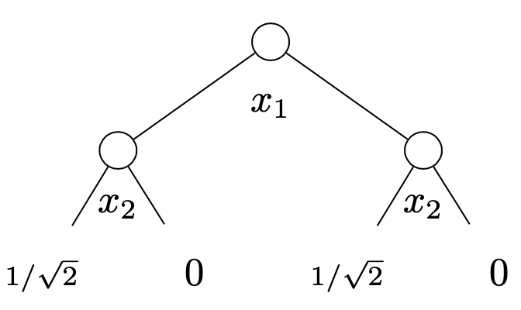
Examples: Tree Automata of Only One Quantum State
This TA of the quantum state

Slide 21
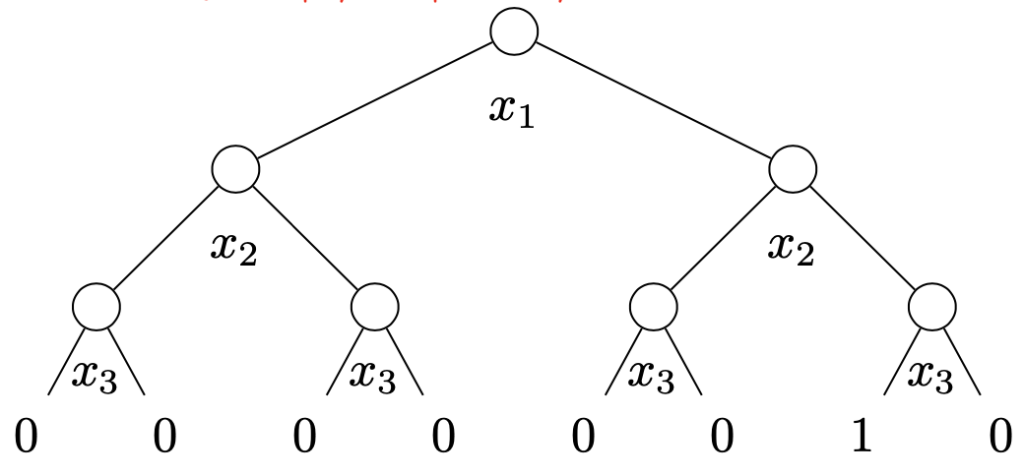
Examples: Tree Automata Encoding of Quantum States
This TA accepts all 3-qubit basis quantum states
$\{|\left.000\right\rangle ,|\left.001\right\rangle ,|\left.010\right\rangle ,|\left.011\right\rangle ,$ $|\left.100\right\rangle ,|\left.101\right\rangle ,|\left.110\right\rangle ,|\left.111\right\rangle \}$

Slide 22
TA as Compact Representation of Quantum States
This TA accepts all 2^{n} basis states. # of transitions: 3n+1
Why it can be some compact? Merge shared structures.
Notes:
好處，比較 compact！
右側的稱為 transition rules.

Slide 23
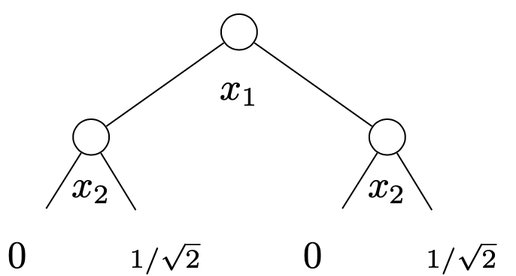
Examples of Gate Operations: X gate on qubit 2.
Notes:
這邊只是給一個 TA gate operation 的例子，不打算詳細解釋。

Slide 24
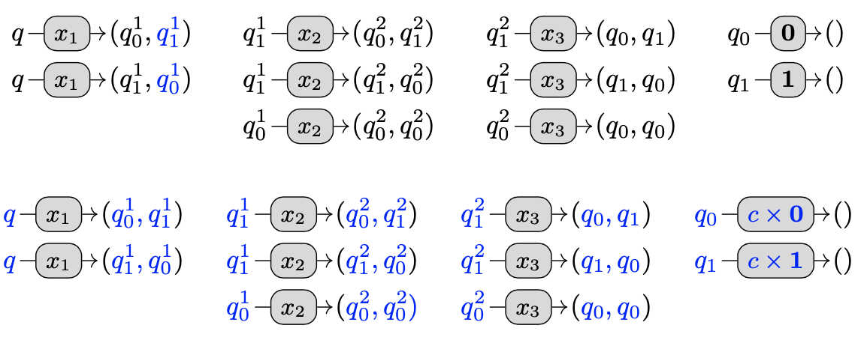
Example of Gate Operations: Z, S, T gates on qubit 1.
Multiply the right subtree of x₁ with some constant c.
Notes:
這邊只是給一個 TA gate operation 的例子，不打算詳細解釋。

Slide 25
Example of Gate Operations: Z, S, T gates on qubit 1.
Multiply the right subtree of x₁ with some constant c.
Other gates? In the paper.
Our framework allows all quantum gates supported in conventional quantum computers.
Notes:
這邊只是給一個 TA gate operation 的例子，不打算詳細解釋。

Slide 26
Extension: Symbolic Tree
C
A Symbolic Tree (State), s
The state after executing C, C(s)

Slide 27
Outline
Minimal Quantum Background and Motivation
Quantum Circuit Verification in the Hoare-Style
Evaluation

Slide 28
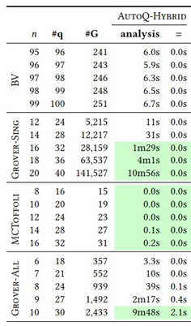
Experiment - Verification
BV, Grover-Sing: $\left|P\right|=1$
MCToffoli, Grover-All: $\left|P\right|≫1$
Notes:
前兩個大 row 是 single state simulation 的部分，電路規模小的時候，SliQSim 贏，電路規模大的時候，AutoQ 贏。
下兩個大 row 是 multiple states simulation 的部分，因為 AutoQ 對 Toffoli 可以加速，所以勝利，Grover-All 的趨勢就跟前兩個大 row 一樣。

Slide 29
Experiment – Bug Hunting
Create $C_{bug}$ by appending one random gate at a random qubit to $C_{ori}$.
Check if $C_{bug}$≠$C_{ori}$ by testing them with different initial state sets $P$.
Useful in compiler validation
Notes:
找 bug 我們大部分都贏，只有一部份是 Feynman 和 Qcec 贏。
值得注意的是，當時候的 QCEC 還不健全，我們順便發現了 QCEC 的 bug 並發 issue 到 GitHub repo。

Slide 30
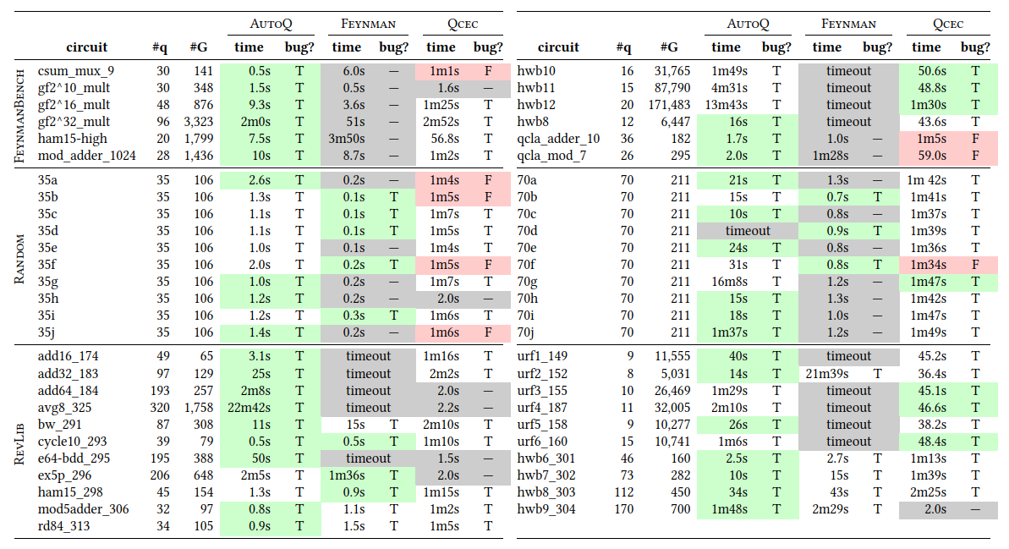
Experiment – Bug Hunting
https://github.com/meamy/feynman
https://github.com/cda-tum/qcec
Notes:
找 bug 我們大部分都贏，只有一部份是 Feynman 和 Qcec 贏。
值得注意的是，當時候的 QCEC 還不健全，我們順便發現了 QCEC 的 bug 並發 issue 到 GitHub repo。

Slide 31
Summary:
Interesting link between automata and quantum states.
So far only basic TA has been tried, there are many more possibilities.
The main reason for efficiency, the compact structure of TA.
Welcome for more discussions!

Slide 32
State-of-the-Art
We focus on fully automatic approaches:
Quantum Simulation
low coverage
Quantum Abstraction Interpretation
over approximation and cannot catch bugs
Quantum Model Checking
only work for small examples
Circuit Equivalence Checking
inflexible for user custom properties

Slide 33
Two Approaches for TA Gate Operations
Permutation-based approach:
Faster, but works for a smaller set of gates.
Done by directly modifying TA transitions.
Composition-based approach
Slower, but complete for universal quantum computing.
Notes:
不能直接對 predicate 條件做運算，剛剛有提到學 simulator，故以一堆量子態來代表 predicate。

Slide 34
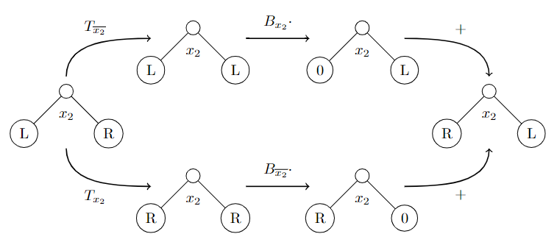
X gate operating on qubit 2
$B_{x_{2}}⋅T_{\overline{x_{2}}}+B_{\overline{x_{2}}}⋅T_{x_{2}}$
Projection
Restriction
Binary Operation
Projection
Restriction
Notes:
Take “X gate operating on bit-2” as the example.

Slide 35
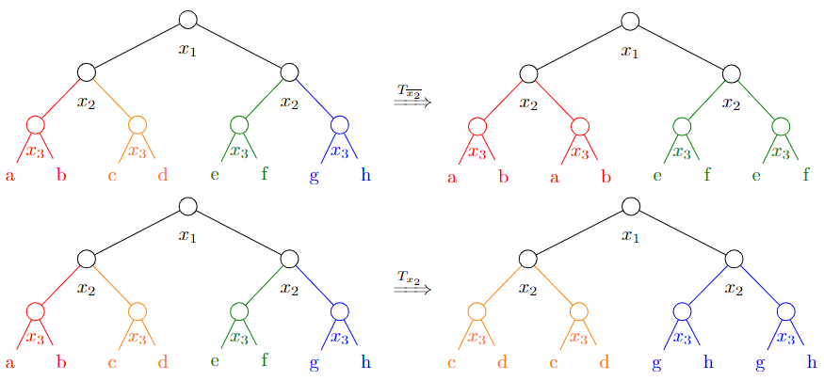
1. Projection ($T_{\overline{x_{2}}}$ & $T_{x_{2}}$)

Slide 36
2. Restriction ($B_{x_{2}}⋅$ & $B_{\overline{x_{2}}}⋅$)
$B_{x_{2}}⋅T_{\overline{x_{2}}}$

Slide 37
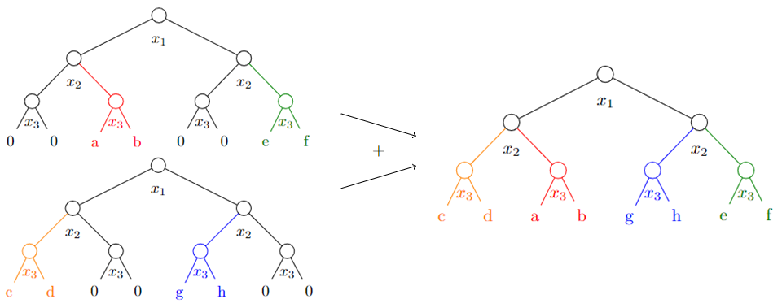
3. Binary Operation ($+$ & $−$)
$B_{x_{2}}⋅T_{\overline{x_{2}}}+B_{\overline{x_{2}}}⋅T_{x_{2}}$

Slide 38
4. Constant Multiplication (c $⋅$)
(-1)$⋅T$

Slide 39
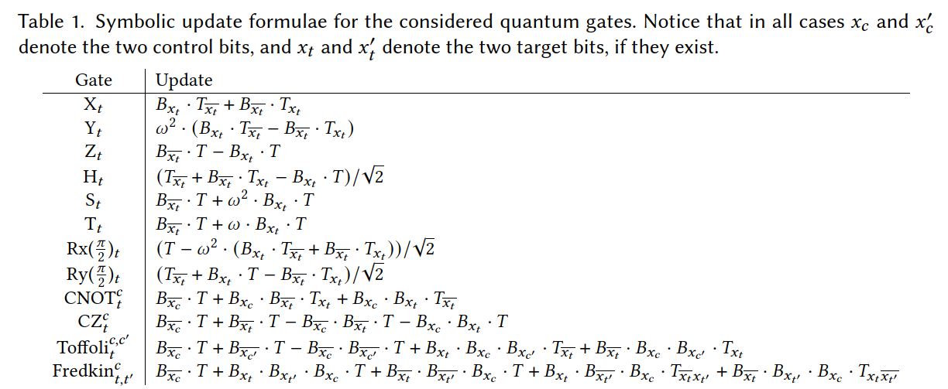
Tree Operations
Notes:
How to manipulate the original tree to obtain the resulting tree?
How to construct CNOT?
There are four template operations.

Slide 40
Lift these operations to TA
Constant Multiplication
Restriction
Binary Operation
Projection
need to say the same left and right subtrees.

